Slide 1
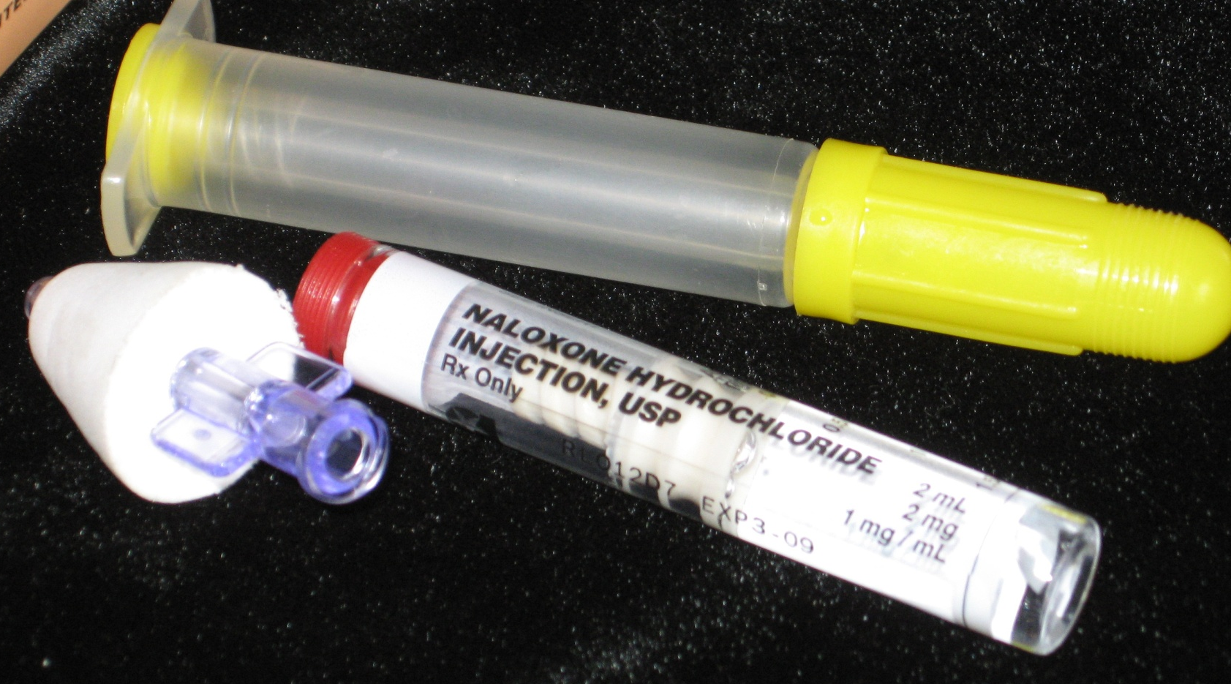
WREMAC BLS Naloxone In-service
Adapted from:
Community Access Naloxone Is there a downside?
Michael W. Dailey, MD Albancy Medical Center

Slide 2
Motor vehicle traffic, poisoning, drug poisoning, and unintentional drug poisoning death rates: United States, 1999--2010
NOTES: Drug poisoning deaths are a subset of poisoning deaths. Unintentional drug poisoning deaths are a subset of drug poisoning deaths.
SOURCE: CDC/NCHS, National Vital Statistics System; and Warner M, Chen LH, Makuc DM, Anderson RN, Miniño AM. Drug poisoning deaths in the United States, 1980–2008. NCHS data brief, no 81. Hyattsville, MD: National Center for Health Statistics. 2011. http://www.cdc.gov/nchs/data/databriefs/db81.htm. Intercensal populations http://www.cdc.gov/nchs/nvss/bridged_race/data_documentation.htm
Notes:
Major point here is that this is a national issue, not just one that concerns those of us in drug treatment. People may ask about unintentional- yes it is sometimes unclear if a given death was intentional or unintentional.

Slide 3
Heroin User Experiences
About 2% of heroin users die each year- many from heroin overdose
1/2 to 2/3 of heroin users experience at least one nonfatal overdose
80% have observed an overdose
Sporer BMJ 2003, Coffin Acad Emerg Med 2007
Notes:
Do staff ask about overdose experiences?
What qualifies as an overdose? That is not well defined, even in much of the medical literature.

Slide 4
Who overdoses?
Among heroin users it has generally been those who have been using 5-10 years
After rehab
After incarceration
Less is known about prescription opioid users
Anecdotal reports of youth dying suggest that many of those have been in drug treatment and relapse
Sporer 2003, 2006
Notes:
Thus we can reach out to some of those at risk in drug treatment, syringe exchange. Where else?

Slide 5
Physiology
Generally happens over course of 1-3 hours
The stereotype “needle in the arm” death may be only about 15%
Opioids repress the urge to breath – decrease response to carbon dioxide – leading to respiratory depression and death
Slow breathing=>Breathing stops=>Heart stops…
Notes:
The key is that there is time to respond to an overdose

Slide 6
Context of Opioid Overdose
The majority of heroin overdoses are witnessed (gives an opportunity for intervention)
Fear of police may prevent calling 911
Witnesses may try ineffectual things
Myths and lack of proper training
Abandonment is the worst response
Tracy 2005
Notes:
Since most overdoses that look like they may be fatal are not (it is estimated that 1-2/10 are fatal) people have reason to believe that interventions like salt shots are effective

Slide 7
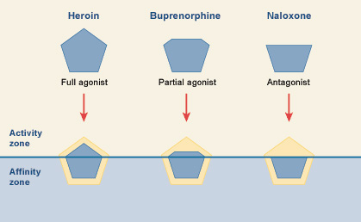
Naloxone (Narcan)
Opioid antagonist which reverses opioid overdose: injectable or intranasal
Has a higher affinity for opioid receptors than most opioids- occupy and block the receptors for for 30-90 minutes
Analogy- getting the wrong key stuck in a lock
Notes:
To be more precise: The naloxone has a higher affinity for the receptors rather than “pushing” off the other opioids. Buprenorphine has even a higher affinity so naloxone is not effective at low doses.

Slide 8
Naloxone in Action
Causes sudden withdrawal in the opioid dependent person – an unpleasant experience
No psychoactive effects – low potential for diversion, is not addictive
Routinely used by EMS (but often in larger doses)
Has no effect if an opiate is not present
Sold over the counter in Italy since 1988

Slide 9
Implementation in NY State
Over 100 sites registered including:
Syringe exchange/syringe access sites
Hospitals
Drug Treatment Programs
HIV programs
Homeless shelters
Notes:
Not all are currently up and running

Slide 10
Boston EMS’ Naloxone program
Hundreds of Reversal
No significant complications to patients
No injuries to providers

Slide 11
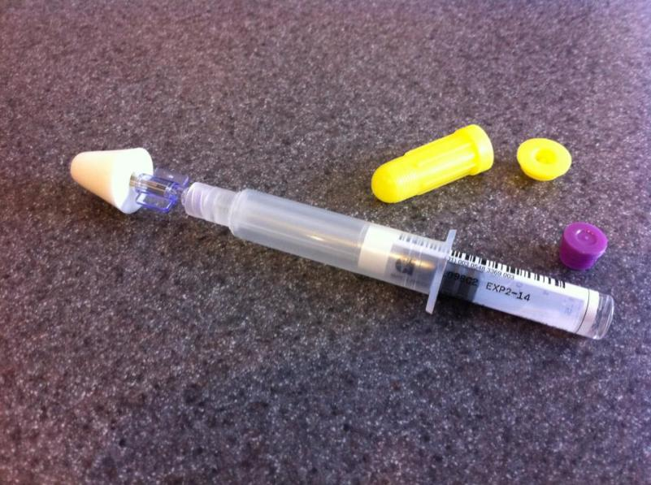
Intranasal naloxone

Slide 12
Advantages of intranasal administration
Nose is easy access point for medication and delivery
Painless
Eliminates risk of a contaminated needle stick

Slide 13
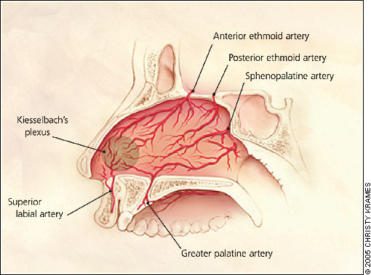

Slide 14
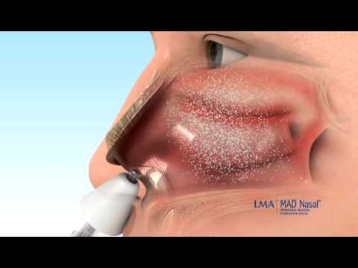

Slide 15
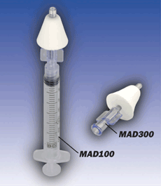
Problems with IN Naloxone
Vasoconstrictors (cocaine) prevent absorption
Bloody nose, nasal congestion, mucous
Lack of nasal mucosa
>1 ml per nostril likely to run off

Slide 16
Risk Factors for Opioid Overdose
Reduced Tolerance
Using Alone (risk factor for fatal OD)
Illness
Depression
Unstable housing
Mixing Drugs
Changes in the Drug Supply
History of previous overdose
Notes:
We want to be sure that all of the overdose responders remember reduced tolerance and mixing drugs.

Slide 17
Some Opioids:
Heroin
Morphine
Fentanyl
Dilaudid
Demerol
Norco
Vicodin
Codeine
Methadone
Hydrocodone
Oxycodone
Oxycontin
Lortab
Percocet

Slide 18
Most Opiate Overdoses will have pinpoint pupils

Slide 19
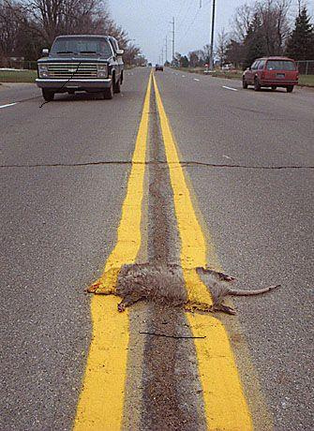

Slide 20
What do we know so far…in one year
1,978 EMTs trained
Over 200 opioid overdose reversals (40% Suffolk PD)
1 reversal for every 10 EMTs trained
No adverse events
No significant hazards to EMS personnel
Case of reduced hazard for EMS personnel

Slide 21
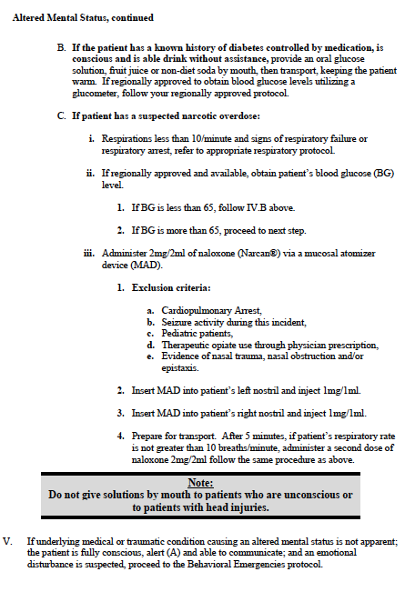

Slide 23
An Opiate OD with any of these could likely benefit from Naloxone,
call for medical direction

Slide 24
Naloxone is in the Altered Mental Status protocol, but, it really belongs in the Respiratory Protocol

Slide 25
Putting it all together (literally)
Remove the caps (red and yellow plastic ends) from the vial of Naloxone and the syringe barrel.
Insert the vial into the barrel & turn the vial 3 times – slowly and gently – until it stops.
Twist the nasal atomizer onto the tip of the syringe. The Naloxone is now ready to use.

Slide 28
Lets Play Do They Need Naloxone….

Slide 29
Lets Play Do They Need Naloxone….
50 year old male, with heroin syringe in arm
Moans to pain (sometimes)
Vitals: BP 126/82, P 100, R 16, SPO2 98%

Slide 30
Lets Play Do They Need Naloxone….
20 year old male, combative

Slide 31
Lets Play Do They Need Naloxone….
32 year old male found in bed unresponsive
Vitals: BP 126/82, P 100, R 8, SPO2 60%

Slide 33
Bottom Line?
Opioid Drugs and make people stop breathing
Naloxone is a safe drug for EMS use
Giving Intranasal medication is easy
EMT-B can save lives with naloxone

Slide 34
Manage the Airway Based on BLS protocols until patient is able to oxygenate normally

Slide 35
Common side effects
Anger (The sudden urge to kick someone’s ass)
Nausea, Vomiting, Diarrhea
Hypertension, Tachycardia
Unmasking of other ingestions
Lowers seizure thresholds
All side effects pale in comparison to the danger of hypotension

Slide 36
Can you give naloxone if you are not sure what they took?
Yes, but you should have some suspicion of opiate overdose
Situational
Pinpoint pupils, hypoventilation

Slide 37
Does it matter if someone OD’d on a street drug or a prescription drug?
No, both may case respiratory depression, and both can be re

Slide 38
What happens if we give it to someone who is not an opiate overdose.
Naloxone only effects patients with opiate in their system

Slide 39
Can you give in in a cardiac arrest?
ALS providers use naloxone in codes. Intranasal absorption is minimal in CPR so patients in cardiac arrest are not included in BLS standing orders.
A cardiac arrest patient may benefit from nasal naloxone, but BLS providers must call medical control before administration.

Slide 40
Is this for treating altered mental status or respiratory depression?
Respiratory Depression
(that’s what kills you)

Slide 41
What if they are very altered?
If some one is altered, and even unresponsive, but breathing adequately they do not require naloxone

Slide 42
Demonstration of IN Naloxone

